Slide 1
ENG 346 Data Structures and Algorithms for Artificial Intelligence Python Basics
Dr. Mehmet PEKMEZCİ
mpekmezci@gtu.edu.tr
https://github.com/mehmetpekmezci/GTU-ENG-346

Slide 2
Codes
https://github.com/mehmetpekmezci/GTU-ENG-346/tree/main/python-codes

Slide 3
Rules
Write READABLE and EASY-TO-MAINTAIN code !!!
Self Descriptive Code : Always use long descriptive names for functions/classes/variables. Do not use i,j .…
All variables are on top ( Class/function or python file)
All imports are on top.
Do not use numbers directly, first assign them to a variable.
(e.g. if distance>100, MAX_DISTANCE=100;if distance >MAX_DISTANCE)
Constant variable names are all capital (e.g. MAX_DISTANCE)
Minimum usage of global variables, always use local variables.

Slide 4
About Python
Python is an interpreted, object-oriented and high-level programming language.
C/C++/Rust/GO → compiled into binary (machine language)
Java → compiled into byte code, then byte codes are interpreted by jvm
Perl/PHP/Python/Shell Scripts (Bash) → Directly interpreted by their interpreter programs.
Created by Guido van Rossum, a Dutch programmer, in 1989.
First public release: Python 0.9.0 in 1991.
Python 2.0 released in 2000.
Python 3.0 released in 2008.

Slide 5
How to Access Python Interpreter?
Official Website: https://www.python.org/
Interpreter + pip
Jupyter notebook via “jupyter” package
Anaconda: https://anaconda.org/
Interpreter + conda + pip
Jupyter notebook via “jupyter” package
Google Colab: https://colab.research.google.com/
Via Colab notebooks (like Jupyter notebooks)
Kaggle: https://www.kaggle.com/
Via Kaggle notebooks (like Jupyter notbooks)

Slide 6
OR - Windows Subsystem for Linux (WSL)
## https://learn.microsoft.com/en-us/windows/wsl/install
## https://ubuntu.com/desktop/wsl
## In poweshell :
Wsl --list --online
Wsl --install Ubuntu-24.04
Wsl -d Ubuntu-24.04
## Linux Shell Starts Here
sudo apt update
sudo apt install python3-pip
pip3 install matplotlib numpy pandas
## The first time you run code from Ubuntu, it will trigger a download of the necessary dependencies:
code .

Slide 7
Python Basics
Variable naming: case-sensitive (e.g., temp vs Temp vs TEMP)
Reserved words: cannot be used as variables.
False as continue else from in not return yield None assert def except global is or try True break del finally if lambda pass while and class elif for import nonlocal raise with
Dynamically typed: No declarations are needed for the variables.
Everything is basically an Object.
Indentation is very important !

Slide 8
Indentation
CORRECT
INCORRECT
import sys
def main():
if len(sys.argv) < 2 :
print("Usage: python3 main.py <first_argument>")
exit(1)
FIRST_ARGUMENT=float(sys.argv[1])
COEFFICIENT=6.75
RESULT=COEFFICIENT*FIRST_ARGUMENT
print(f"RESULT={RESULT}")
USER_INPUT=input("Enter Another VALUE: ")
RESULT=COEFFICIENT*float(USER_INPUT)
print(f"2. RESULT={RESULT}")
if __name__ == '__main__':
main()
import sys
def main():
if len(sys.argv) < 2 :
print("Usage: python3 main.py <first_argument>")
exit(1)
FIRST_ARGUMENT=float(sys.argv[1])
COEFFICIENT=6.75
RESULT=COEFFICIENT*FIRST_ARGUMENT
print(f"RESULT={RESULT}")
USER_INPUT=input("Enter Another VALUE: ")
RESULT=COEFFICIENT*float(USER_INPUT)
print(f"2. RESULT={RESULT}")
if __name__ == '__main__':
main()

Slide 9
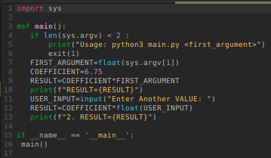
Arguments and User Input
main.py
OUTPUT
mpekmezci@cobalt:/tmp$ python3 main.py
Usage: python3 main.py <first_argument>
mpekmezci@cobalt:/tmp$ python3 main.py 7
RESULT=47.25
Enter Another VALUE: 8
2. RESULT=54.0
mpekmezci@cobalt:/tmp$

Slide 10
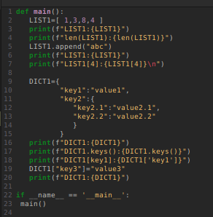
Lists and Dictionaries
main.py
OUTPUT
mpekmezci@cobalt:/tmp$ python3 main.py
LIST1:[1, 3, 8, 4]
len(LIST1):4
LIST1:[1, 3, 8, 4, 'abc']
LIST1[4]:abc
DICT1:{'key1': 'value1', 'key2': {'key2.1': 'value2.1', 'key2.2': 'value2.2'}}
DICT1.keys():dict_keys(['key1', 'key2'])
DICT1[key1]:value1
DICT1:{'key1': 'value1', 'key2': {'key2.1': 'value2.1', 'key2.2': 'value2.2'}, 'key3': 'value3'}

Slide 11
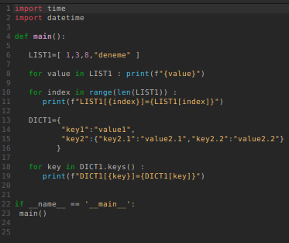
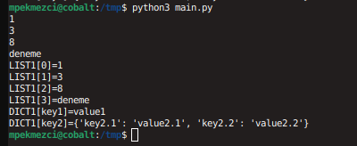
For loop
main.py
OUTPUT

Slide 12
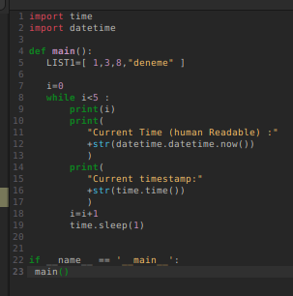
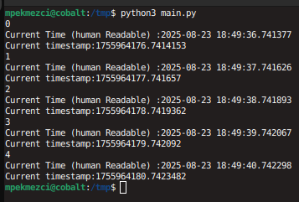
While loop, timestamp, datetime, sleep
main.py
OUTPUT

Slide 13
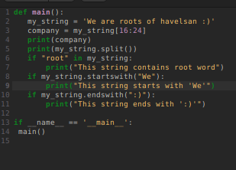
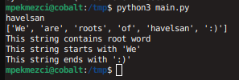
String operations
main.py
OUTPUT

Slide 14
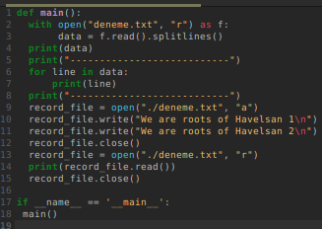
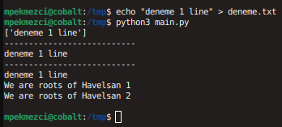
File operations
main.py
OUTPUT

Slide 15
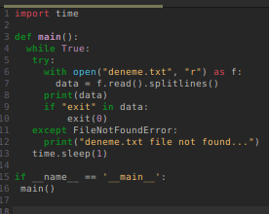
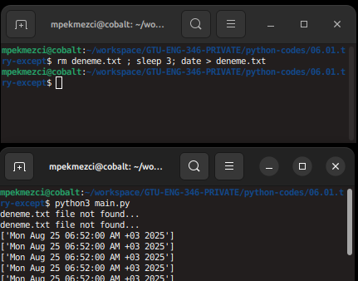
Try-Except
main.py
OUTPUT

Slide 16
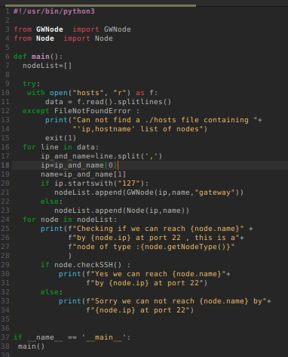
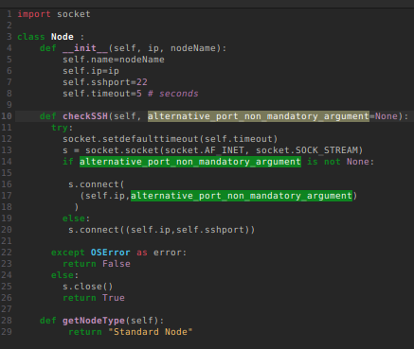
Object Oriented Programming
main.py
Node.py

Slide 17
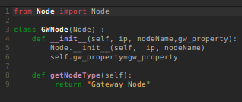


Object Oriented Programming
GWNode.py
hosts
OUTPUT

Slide 18
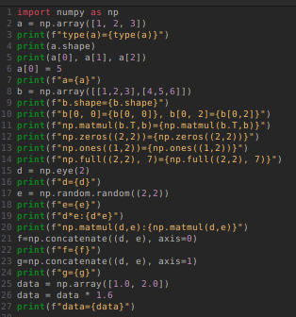
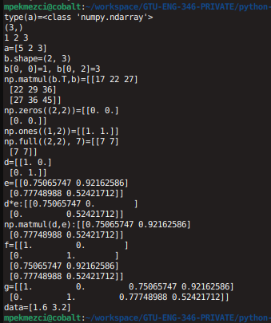
Numpy
main.py
OUTPUT

Slide 19
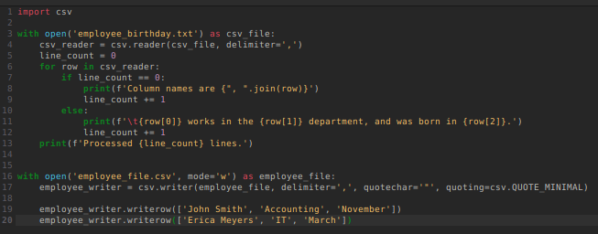
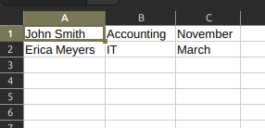

CSV
main.py
employee_file.csv
employee_birthday.txt

Slide 20
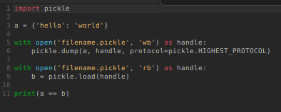
Pickle
main.py
OUTPUT

Slide 21
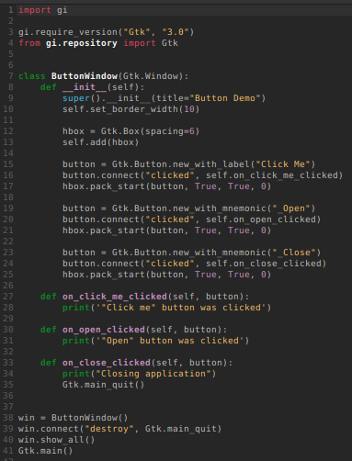


Python GUI - GTK - Button
main.py
OUTPUT

Slide 22
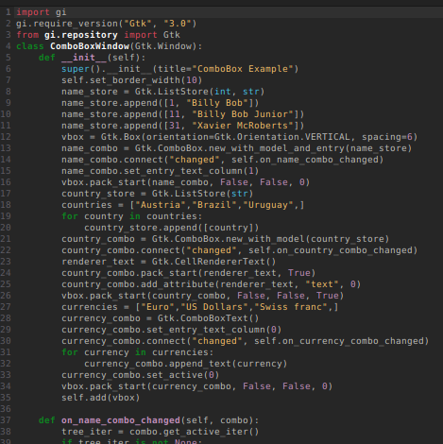
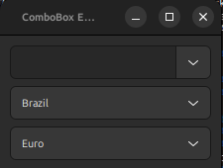
Python GUI - GTK - Combobox
main.py
OUTPUT

Slide 23
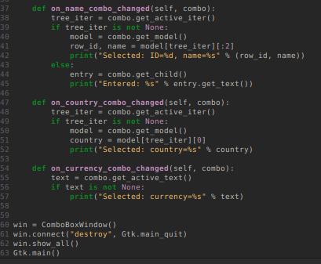
Python GUI - GTK - Combobox
main.py
OUTPUT

Slide 24
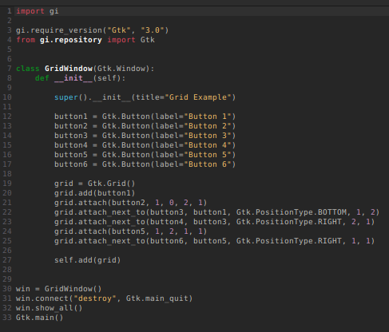
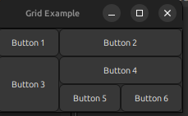
Python GUI - GTK - Grid
main.py
OUTPUT

Slide 25
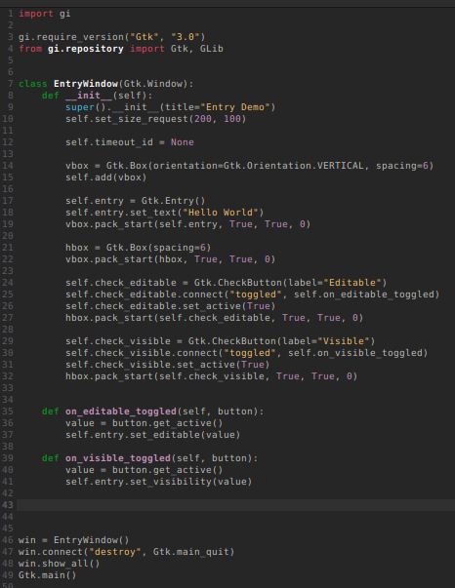
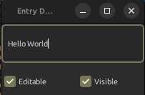
Python GUI - GTK – Input Text
main.py
OUTPUT

Slide 26
Built-in Types
Type | Description
bool | Boolean value
int | Integer
float | Floating-point number
list | Mutable sequence of objects
tuple | Immutable sequence of objects
str | Character string
set | Unordered set of distinct objects
frozenset | Immutable form of set class
dict | Dictionary (Associative mapping)
Notes:
Immutable: cannot be changed

Slide 27
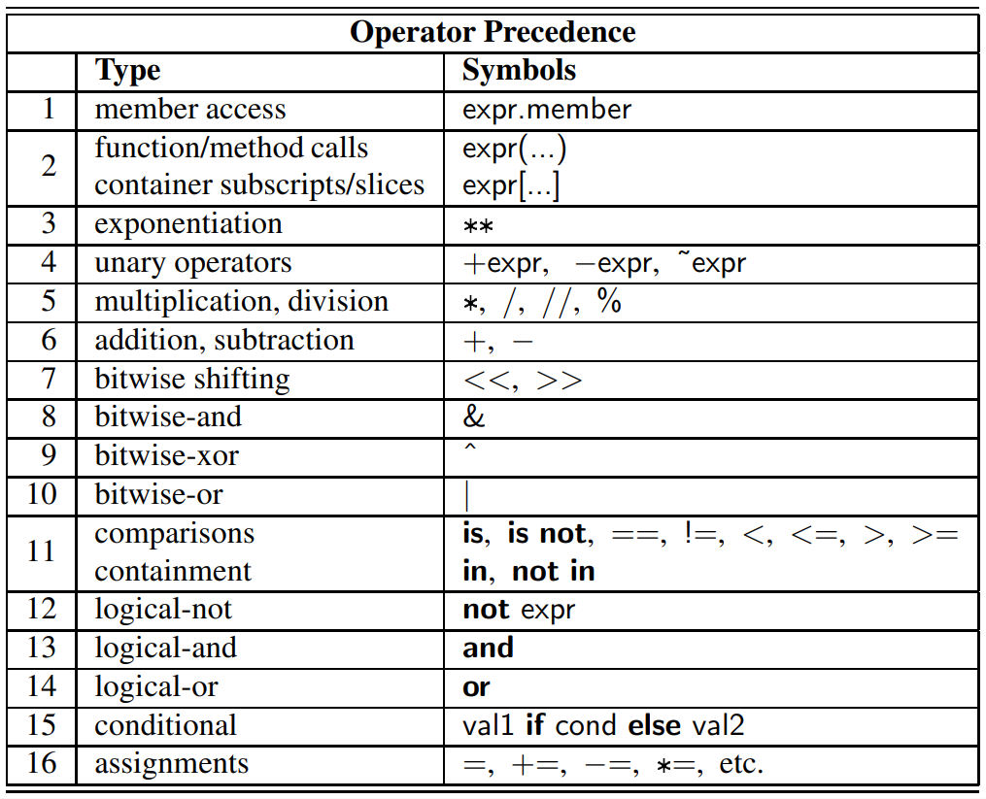
Operators

Slide 28
Control Flow
if first condition:
first body
elif second condition:
second body
elif third condition:
third body
else:
fourth body

Slide 29
Loops
while condition:
body
for element in iterable:
body

Slide 30
Functions
def count(data, target):
n=0
for item in data:
if item == target: # found a match
n += 1
return n

Slide 31
Built-in Functions

